Slide 1
Neural Network - I

Slide 2
MOD1: The Make of an artificial Neuron

Slide 3


REVIEW: Perceptron
A linear model
$$a=w_{1}x_{1}+w_{2}x_{2}+…+w_{p}x_{p}+b$$
Decision based on $a$:
$$\begin{matrix}y=-1, & a<0 \\ y=+1, & a≥0\end{matrix}$$
bias
-1
Weights
Attributes
…
+1
Threshold-
Classification

Slide 4
PERCEPTRON in a DATA SpacE
w[0] = 1.0
w[1] = 2.0
a = 1.0 * x[0] + 2.0 * x[1]
1.0
x[1]
GEOMETRIC INTERPRETATION OF A-VALUES
Colours are corresponding to “a” values at every possible point in the data space
0.0
x[0]
1.0

Slide 5
LIMITATION of A PERCEPTRON
1.0
1.0
Q: On which data set, a perceptron COULD achieve 0-training error:
(1), the data set represents underlying linear-separable distributions; data in (2) and (4) are not representative enough.
(1 and 4), similar to (A), but (4) has enough samples, as many as (1)
All, as you can change the parameters of a perceptron to fit data.
(1, 2, and 4)
x[1]
x[1]
1
2
0.0
x[0]
1.0
0.0
x[0]
1.0
1.0
1.0
x[1]
x[1]
3
4
0.0
x[0]
1.0
0.0
x[0]
1.0

Slide 6


GENERALISE A PERCEPTRON
Q: Your idea on extending a perceptron?
Activation
Sum
Transform $x^{′}s$
$$x_{1}$$
B
$$∑$$
A
C
$$h$$
$$x_{2}$$
Perceptron
$$w_{1}$$
$$×$$
$$x_{1}$$
$$∑$$
$$h$$
$$w_{2}$$
$$×$$
Be specific about “EXTEND” — consider how the capacity of an original perceptron is implemented.
$$x_{2}$$

Slide 7
PERCEPTRON.X
$$x_{1}$$
$$∑$$
A
$$h$$
$$x_{2}$$
output activation
input weighted sum

Slide 8


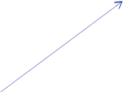

PERCEPTRON.X
B
$$∑$$
$$+$$
$$x_{1}$$
$$h_{1}$$
$$∑$$
$$+$$
$$x_{2}$$
$$h_{2}$$

Slide 9
input-transformed PERCEPTRON
$$w_{1}$$
$$×$$
$$g^{1}(\overset{⃗}{x})$$
$$x_{1}$$
$$∑$$
$$h$$
$$w_{2}$$
$$×$$
$$g^{2}(\overset{⃗}{x})$$
$$x_{2}$$

Slide 10
input-transformed PERCEPTRON
$$w_{1}$$
$$×$$
$$g^{1}(\overset{⃗}{x})$$
$$x_{1}$$
$$∑$$
$$h$$
$$w_{2}$$
$$×$$
$$g^{2}(\overset{⃗}{x})$$
$$x_{2}$$
Q: In the example, when we use $sin(ω_{1}⋅x_{1})$ as transform-1 and $sin(ω_{2}⋅x_{2})$ as transform-2, how many degree of freedom in the new perceptron model with transformed inputs?
2, $w_{1}$ and $w_{2}$.
4, $w_{1}$, $w_{2}$, $ω_{1}$ and $ω_{2}$.
6, $w_{1}$, $w_{2}$, $ω_{1}$, $ω_{2}$, $x_{1}$ and $x_{2}$

Slide 11

Multi-layer PERCEPTRON
$$×$$
$$∑$$
$$w_{1}$$
$$×$$
$$×$$
$$∑$$
$$h$$
$$x_{1}$$
$$w_{2}$$
$$×$$
$$×$$
$$x_{2}$$
$$∑$$
$$×$$

Slide 12
Multi-layer PERCEPTRON
$$×$$
$$∑$$
$$w_{1}$$
$$×$$
$$×$$
$$∑$$
$$h$$
$$x_{1}$$
$$w_{2}$$
$$×$$
$$×$$
$$x_{2}$$
$$∑$$
$$×$$
Q: How many degrees of freedom in the model?
2.
4
6

Slide 13
EX. Multi-layer PERCEPTRON

Slide 14
Multi-layer PERCEPTRON
$$×$$
$$∑$$
$$w_{1}$$
$$×$$
$$×$$
$$∑$$
$$h$$
$$x_{1}$$
$$w_{2}$$
$$×$$
$$×$$
$$x_{2}$$
$$∑$$
$$×$$
Q: How many degrees of freedom in the model?
2.
4
6

Slide 15

$$×$$
$$∑$$
$$w_{1}$$
$$×$$
$$×$$
$$∑$$
$$h$$
$$x_{1}$$
$$w_{2}$$
$$×$$
$$×$$
$$x_{2}$$
$$∑$$
$$×$$

Slide 16
Multi-layer PERCEPTRON Matrix MULtiplicaiton
$$X$$
$$W$$
$$H$$
$$U$$
$$Y$$

Slide 17
input-transformed PERCEPTRON
$$X⋅W\overset{φ}{→}H,⋅U\overset{φ}{→}Y=φ(φ(X⋅W)⋅U)$$
Collapsed:
$$Y=X⋅W⋅U=X⋅(W⋅U)=X⋅V$$

Slide 18
EX. Multi-layer PERCEPTRON
Using matrix

Slide 19
MOD2: Train an artificial Neuron

Slide 20
Adjust Net OUTPUTs
Gradient Definition
“What if ..” for each parameter
Gradient Computation (Back-propagation)

Slide 21

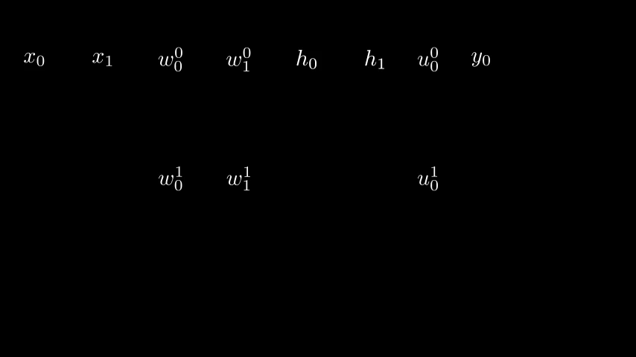
An example
$$w_{0}^{0}$$
$$w_{1}^{0}$$
$$h_{0}$$
$$h_{1}$$
$$u_{1}^{0}$$
$$y_{0}$$
$$x_{0}$$
$$x_{1}$$
$$a_{0}$$
$$a_{1}$$
$$b_{0}$$
$$w_{0}^{1}$$
$$w_{1}^{1}$$
$$u_{1}^{1}$$

Slide 22

BP - 1: y>>B
$$w_{0}^{0}$$
$$w_{1}^{0}$$
$$h_{0}$$
$$h_{1}$$
$$u_{1}^{0}$$
$$y_{0}$$
$$x_{0}$$
$$x_{1}$$
$$a_{0}$$
$$a_{1}$$
$$b_{0}$$
$$w_{0}^{1}$$
$$w_{1}^{1}$$
$$u_{1}^{1}$$
$$\begin{matrix} & \frac{dy}{db} \\ & dy=?db\end{matrix}$$
$$\begin{matrix} & dy=1⋅df(b) \\ & ?=\frac{df(b)}{db} \\ & dy=\frac{df(b)}{db}db\end{matrix}$$
Computable Using B
$$\frac{dSigmoid(b)}{db}=\frac{e^{-b}}{(1+e^{-b})^{2}}$$

Slide 23

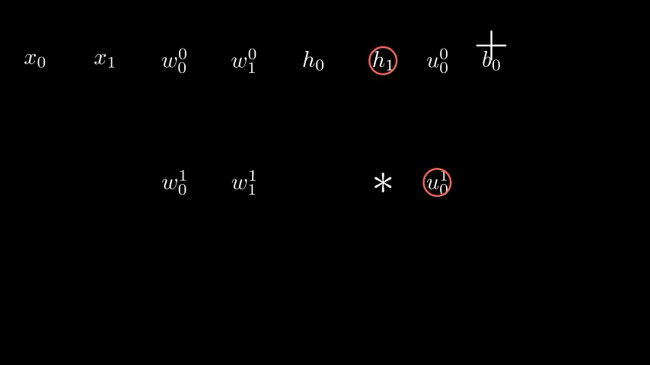
BP - 2: B>>U
$$w_{0}^{0}$$
$$w_{1}^{0}$$
$$h_{0}$$
$$h_{1}$$
$$u_{0}^{0}$$
$$y_{0}$$
$$x_{0}$$
$$x_{1}$$
$$a_{0}$$
$$a_{1}$$
$$b_{0}$$
$$w_{0}^{1}$$
$$w_{1}^{1}$$
$$u_{0}^{1}$$
$$\begin{matrix} & dy=0.5db\end{matrix}$$
$$\begin{matrix} & dy=?du_{0}^{1}\end{matrix}$$
Q: Your option about the “?”:
Influenced by all x’s and w’s.
0, as y depends on b, not u’s.
u10 affects b then y, so ?=0.5, same as b.
u10 affects b then y, its contribution to b is through “*h1” so ?=0.5*h1.
u10 contributes through “*h1”, so ?=h1

Slide 24
BP - 2a: B>>H
$$w_{0}^{0}$$
$$w_{1}^{0}$$
$$h_{0}$$
$$h_{1}$$
$$u_{0}^{0}$$
$$y_{0}$$
$$x_{0}$$
$$x_{1}$$
$$a_{0}$$
$$a_{1}$$
$$b_{0}$$
$$w_{0}^{1}$$
$$w_{1}^{1}$$
$$u_{0}^{1}$$
$$\begin{matrix} & dy=0.5db\end{matrix}$$
$$\begin{matrix} & dy=?dh_{0}\end{matrix}$$
Q: Your option about the “?”:
Don’t care, h is not a learnable parameter.
h0 affects u00 then b then y, ?=0.5*h0*u00, where 0.5*h0 is how u00 affects y
h0 affects b then y, its contribution to b is through “*u00” so ?=0.5*u00. And we DO need to compute h’s effect, as we need to compute how to adjust parameters leading to h.

Slide 25
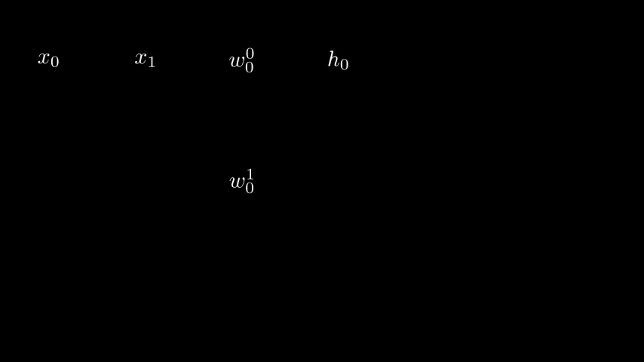
Multi-layer PERCEPTRON COMP.

Slide 26
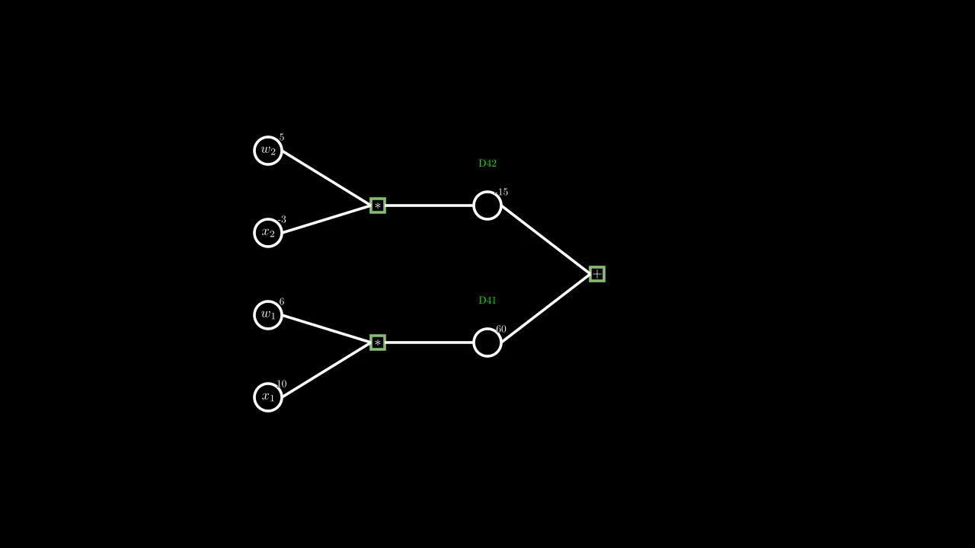
Multi-layer PERCEPTRON COMP.

Slide 27

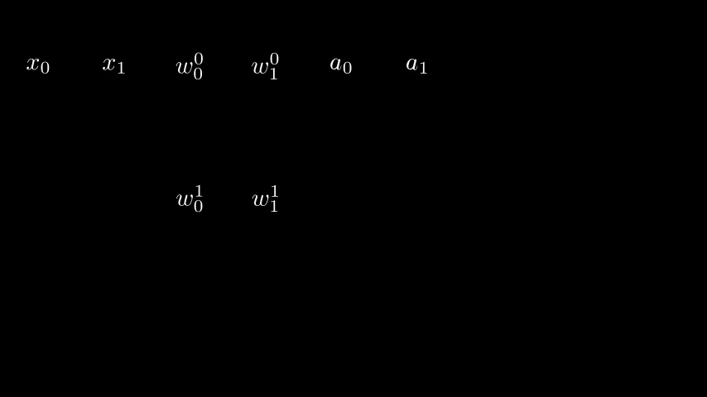
BP - 2a: H>>A
$$w_{0}^{0}$$
$$w_{1}^{0}$$
$$h_{0}$$
$$h_{1}$$
$$u_{0}^{0}$$
$$y_{0}$$
$$x_{0}$$
$$x_{1}$$
$$a_{0}$$
$$a_{1}$$
$$b_{0}$$
$$w_{0}^{1}$$
$$w_{1}^{1}$$
$$u_{0}^{1}$$
$$\begin{matrix} & dy=-0.1dh_{0} \\ & dy=?da_{0}\end{matrix}$$
Similar to B<>Y, element-wise derivative.

Slide 28

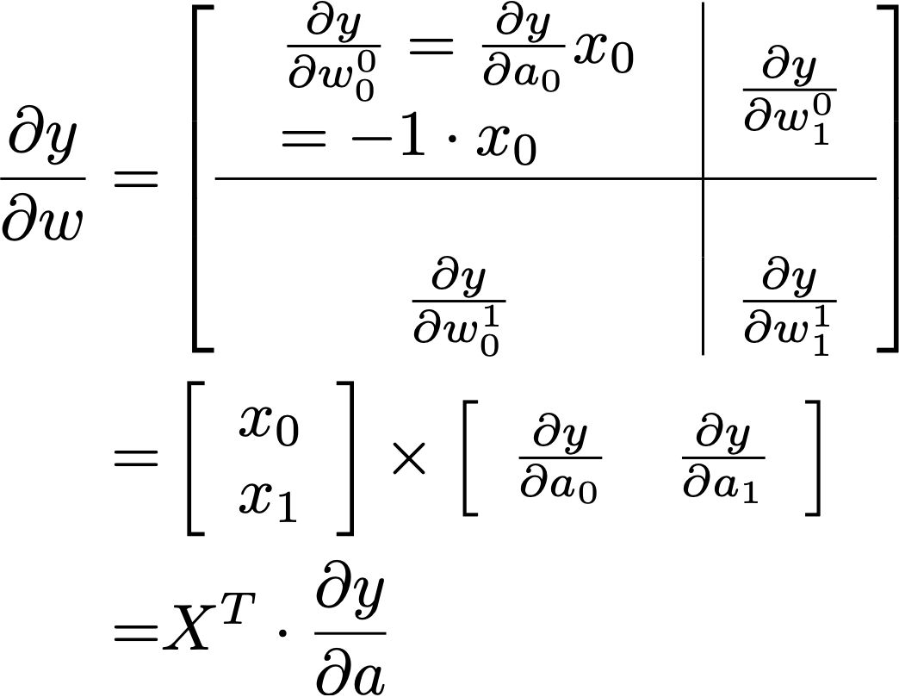
BP - 2a: A>>W
$$w_{0}^{0}$$
$$w_{1}^{0}$$
$$h_{0}$$
$$h_{1}$$
$$u_{0}^{0}$$
$$y_{0}$$
$$x_{0}$$
$$x_{1}$$
$$a_{0}$$
$$a_{1}$$
$$b_{0}$$
$$w_{0}^{1}$$
$$w_{1}^{1}$$
$$u_{0}^{1}$$
$$\begin{matrix} & \frac{∂y}{∂a}=[-1,0.5]\end{matrix}$$

Slide 29
Essentials
When Deployed (Working Condition/Forward Computation)
Connection Structure
Activation Mapping
Training/Learning (Adjusting Parameters)
Gradient Definition
Gradient Computation (Back-propagation)
Learning Material
Information Theory, Ch 39. Fig. 39.4

Slide 30
THANKS

Slide 31
Connections
The “main body” of neuron networks
Where most of the learnable parameters live
Terminology — BIAS
Adjusting parameter -> change behaviour of the net -> training -> selection in the hypothesis
Q: Number of parameters (don’t consider the “bias”)

Slide 32
ACTIVITY
The bone.
Task related - link to loss function.
Interpretation of Logistic regression
Q: Connection Parameters vs Activity who determines
Model member within a family
The model family

Slide 33
Implementation-1
Connection
Activity

Slide 34
Logistic regression explained*
Sigmoid Equation
Explaining Logit (p. 179 of InfoTheory Book)

Slide 35
Implementation-2
Comparison to the target value

Slide 36
stacking more layers

Slide 37
Gradient
Q: Which of the following criteria can be used for binary classification: $v$: model output; $y$: target value
(prediction - y) ** 2
X1 and X2
W1, X1, W2, X2
A
\varphi *(model family)
Y

Slide 38
Gradient
Q: Which part in a Neuron we change during learning?
W1 and W2
X1 and X2
W1, X1, W2, X2
A
\varphi *(model family)
Y

Slide 39
Gradient
Definition
Gradient of PARAMETERS
Why we need to know the gradient of DATA?

Slide 40
Implementation-3
Numerical Gradient

Slide 41
back propagation
Numerical Gradient

Slide 42
Implementation-4
Back Prop

Slide 43
LAB
OWN Architecture
Torch

Slide 44
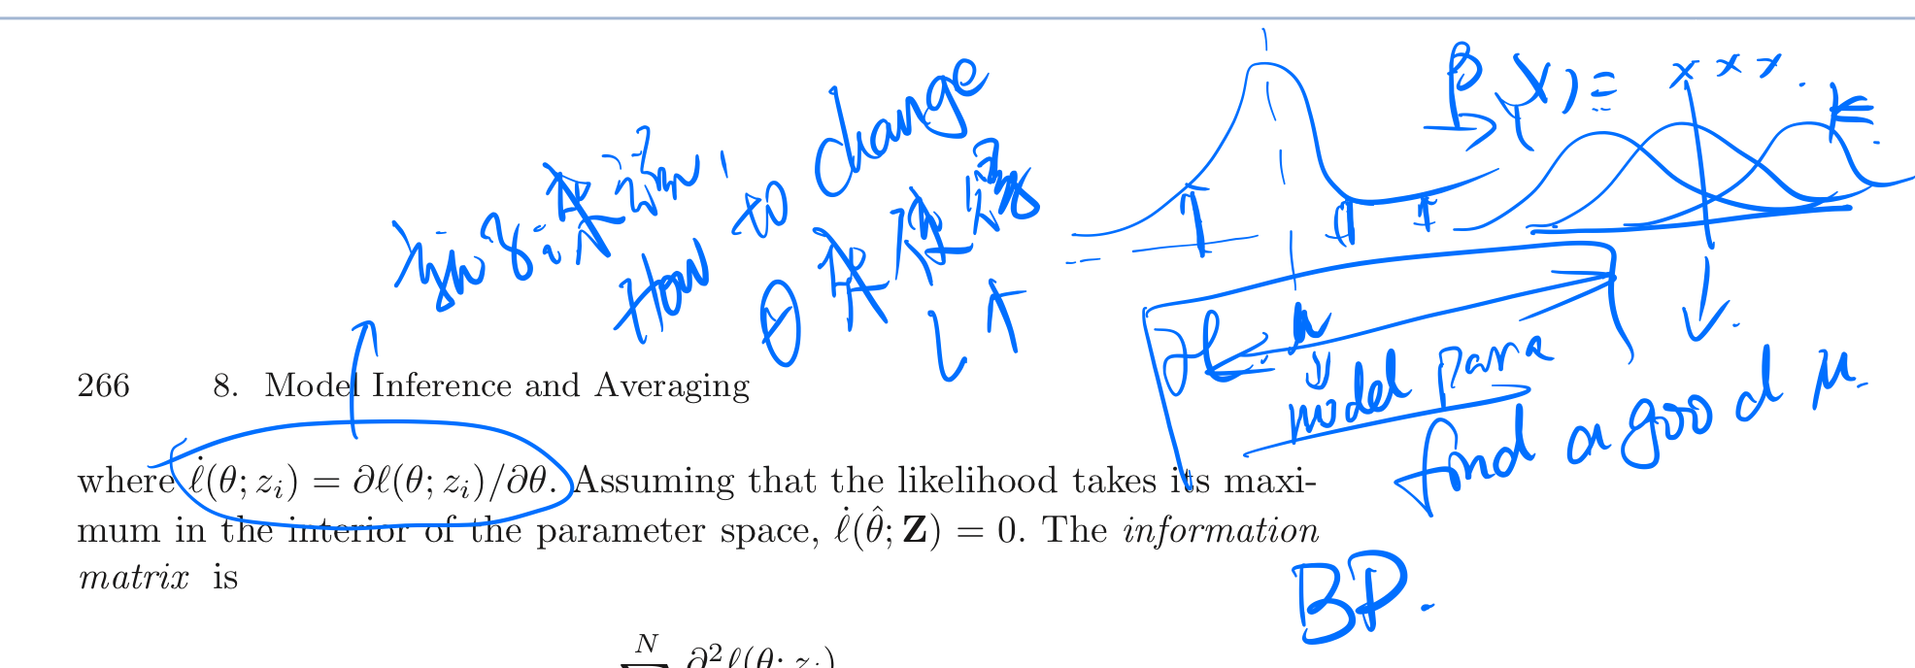
An idea of motivating parameter adjustment
ESL Chapter 8: better shown as 3blue 1brown style

